Slide 1
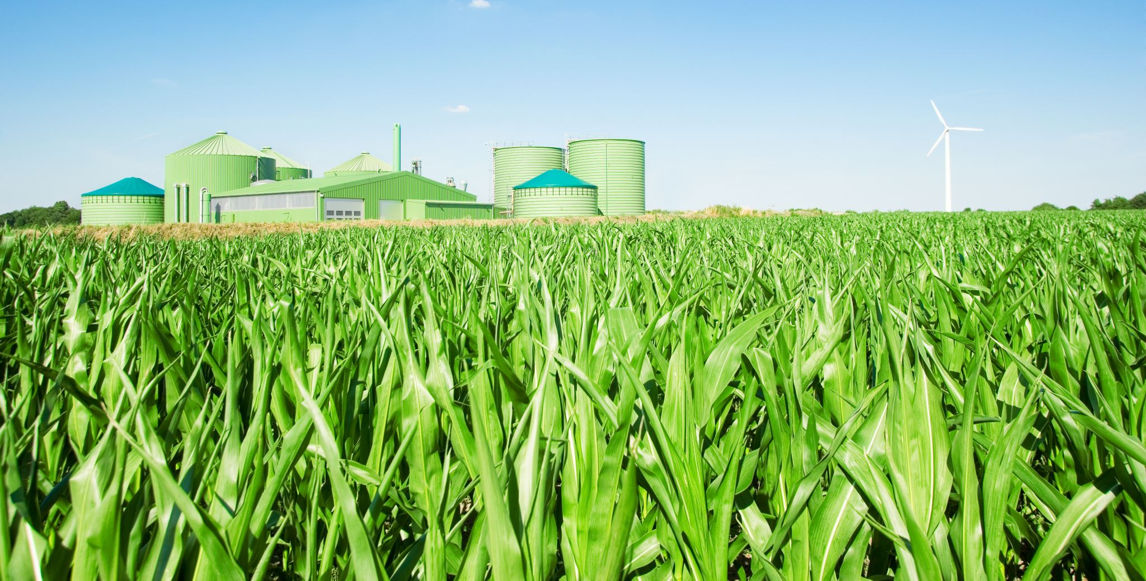
Rural Development and Agricultural Innovation
Presented by:
Anshuman Sinha(043)
Arpita Singh(046)
Avinish Kumar(047)

Slide 2
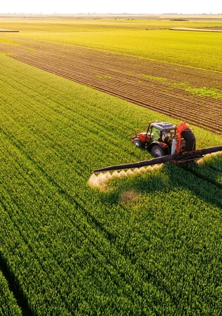
Introduction
Rural development improves
living standards through
infrastructure, education, and
economy, while agricultural
innovation enhances productivity
with modern technology,
sustainable practices, and
government initiatives.
Together, they drive economic
growth, ensure food security, and
empower rural communities for
long-term prosperity and
development.

Slide 3
Key Challenges in Rural Development
Lack of Infrastructure (Roads, Electricity, Water)
Limited Access to Modern Agricultural Techniques
Financial Constraints and Low Credit Accessibility
Climate Change and Its Impact on Agriculture

Slide 4

Government Initiatives for Rural Development
Pradhan Mantri Krishi Sinchayee Yojana (PMKSY): A government initiative to improve irrigation efficiency and ensure water availability for sustainable agricultural practices.
National Rural Employment Guarantee Act (NREGA): A social security scheme providing guaranteed employment to rural households to enhance livelihood security and infrastructure development.
Digital India Initiatives for Farmers: Programs leveraging digital technology to provide farmers with real-time information, market access, and financial inclusion for improved agricultural productivity.

Slide 5
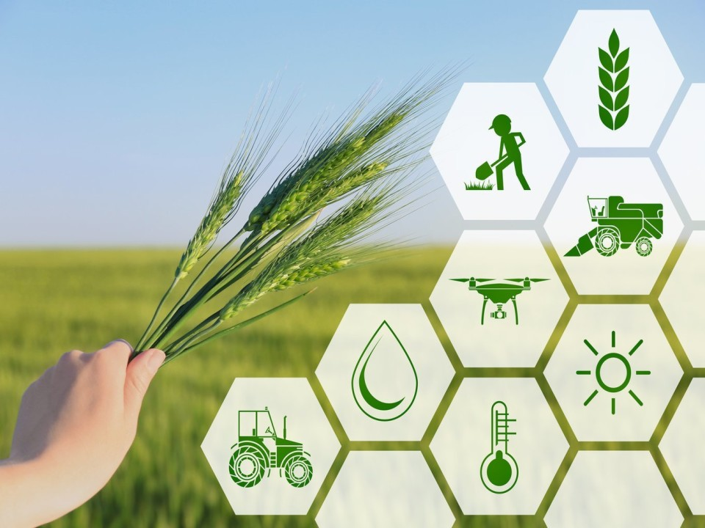
Role of Startups & Private Sector
Agri-tech Startups & Their Impact: Technology-driven startups enhancing productivity, supply chains, and market access for farmers.
Role of E-commerce in Agri-Trade: Online platforms connecting farmers to buyers, ensuring better prices and wider reach.
Financial Services and Microfinance for Farmers: Providing credit, insurance, and banking solutions to support farming investments.
Collaboration Between Private Sector and Farmers: Partnerships improving technology access, training, and market opportunities for farmers.

Slide 6
Future Prospects and Way Forward
Integration of AI & Big Data in Agriculture
Enhancing Rural Connectivity and Infrastructure
Policy Reforms to Support Farmers
Public-Private Partnership in Rural Development

Slide 7

Conclusion
Agricultural development is essential for economic growth, food security, and rural prosperity. By integrating modern technology, sustainable practices, and supportive policies, productivity can be enhanced while ensuring environmental conservation.

Slide 8

Any Questions?

Slide 9
Thank You!

